Slide 1
Research Challenges for
Optical Grid Computing
M. De Leenheer, C. Develder, T. Stevens, J. Vermeir,
F. De Turck, B. Dhoedt, P. Demeester
OGF20, Manchester, UK
May 9, 2007

Slide 2

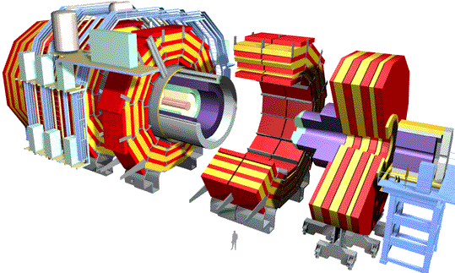
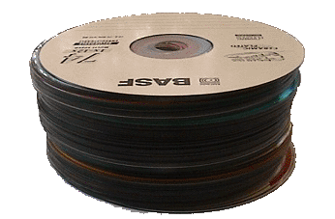
Introduction (1)
eScience:
  By 2015 it is estimated that particle physicists will require exabytes (10¹⁸) of storage and petaflops per second of computation
  CERN’s LHC Computing Grid (LGC) will start operating in 2007 and will generate 15 petabytes annually (that’s ~2Gbit/s)
Balloon
(30 km or
18.6 mi)
CD stack with
1 year LHC data
(~ 20 km or
12.5 mi)
Concorde
(15 km or
~9.3 mi)
Mt. Blanc
(4.8 km,
or 3 mi)
6 cm (~2.4 in)
50 CDROMs
= 35 GB
LHC = Large Hadron Collidor:
particle accellerator

Slide 3

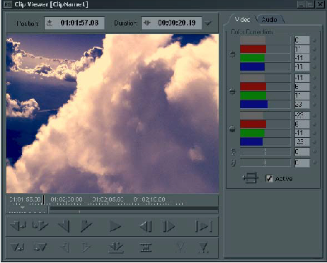
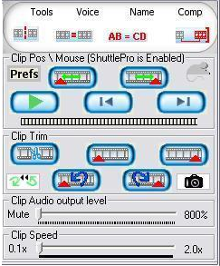
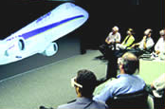
Introduction (2)
Consumer service:
  Eg. video editing: 2Mpx/frame for HDTV, suppose effect requires 10 flops/px/frame, then evaluating 10 options for 10s clip is 50 Gflops (today’s high performance PC: ~10 Gflops/s)
Virtual reality: rendering of 3*10⁸ polygons/s → 10⁴ GFlops
Online gaming:
e.g. Final Fantasy XI: 1.500.000 gamers
Multimedia editing

Slide 4
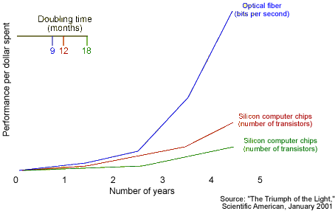
Introduction (3)
Grid opportunities ranging from academia over corporate business to home users
Optical data speeds ≥ internal PC bus speeds
⇒ network speed no bottleneck
eScience grids
service grids
business
consumer
users

Slide 5
Introduction
Network Architecture
Routing
Multiple Domains
Conclusions

Slide 6
Optical Network Architecture
Optical Circuit Switching (OCS)
  continuous bit-stream
  pre-established light-paths
  should be dynamic
Optical Burst/Packet Switching (OBS/OPS)
  chunks of bits, in bursts/packets
  forwarding based on header
  e.g. label switching, GMPLS
Hybrids
c
b
b
c
a
c
d
f
f
e
f

Slide 7
Optical Circuit Switching
Pro:
  Guaranteed service quality once set-up (cf. reserved lambda), thus fixed latency, no jitter, etc.
  Fixed signaling overhead, independent of (large) job size
Con:
  Signaling overhead† not acceptable for relatively small jobs
    Requires (complex) grooming if frequent set-up and tear-downs are to be avoided (i.e. if too slow)
  Less flexible, dynamic than OBS/OPS, cf. light-path set-up and tear-down
†: e.g. 166ms/switch → RSVP-TE speedup needed

Slide 8
OBS/OPS
Pro:
  Extremely flexible, dynamic
  Inherent statistical multiplexing of available bandwidth (over multiple lambdas)
Con:
  Packet/Burst header processing overhead
    Requires job aggregation if job size too small compared to header overhead
  Difficult to deliver strict QoS guarantees without 2-way reservation
  Technology not that mature (hardware)

Slide 9
Hybrid OCS/OBS
Choosing between OCS and OBS depends on…
  Optical technology (OBS requires faster switches, burst mode Rx/Tx and regenerators, …)
  Job sizes:
Hybrid architectures can offer a compromise
Signaling time
Job transmission time
OBS-based
OCS-based
Job size

Slide 10
Hybrid OBS/OCS
Parallel: choice to either set-up OCS circuit between source & destination, or use OBS
  Note: can be overlay, where OBS makes use of OCS connections between OBS nodes
Data plane choice
Aggregation
Node architecture
Note: CHEETAH proposes a similar approach with IP and SONET as parallel layers

Slide 11
Hybrid OBS/OCS: ORION
Overspill Routing In Optical Networks:
A
D
B
C
Burst switching
C
A
A→D
B→D
B
D
C→D
overspill
A→B
overspill
Circuit switching

Slide 12
Introduction
Network Architecture
Routing
Multiple Domains
Conclusions

Slide 13
Optical Grid specifics
Differences with “classical” optical networks or “classical” Grids:
  Anycast routing: user generally doesn’t care where job is executed
  Burst starvation: not only network contention, also Grid resource contention
  Future reservation†: some jobs have very loose response time requirements, others are known long beforehand
†: note that current control planes such as GMPLS do not allow this (yet)

Slide 14
Problem Statement
Problem:
  Given a job, submitted by a user to an anycast address
  Find a set r containing at least one (and preferably one) suitable Grid site location accepting such jobs
Sub-problems:
  Routing/deflection strategies
  Distributed multi-constrained routing algorithms
?
JOB

Slide 15
Anycast SAMCRA
Problem:
  Incorporation of other metrics than just Grid resource availability leads to a multiple-constraint anycast routing problem
  (unicast multiple-constraint is already NP-complete)
Our solution:
  Introduce virtual topology to translate to unicast

Slide 16
Anycast SAMCRA
Problem:
  Incorporation of other metrics than just Grid resource availability leads to a multiple-constraint anycast routing problem
  (unicast multiple-constraint is already NP-complete)
Our solution:
  Introduce virtual topology to translate to unicast
  Use a Self-Adaptive Multiple Constraint Routing Algorithm (SAMCRA)
  Use a novel path ordering avoiding sub-optimality and loops

Slide 17
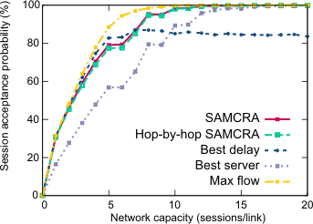
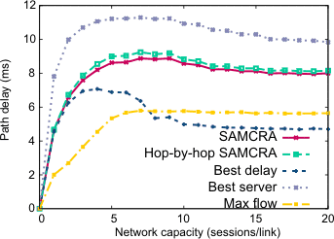
Anycast SAMCRA: results
Comparison with a Maximum-Flow upper bound shows that even distributed SAMCRA comes very close to (pseudo-)optimal acceptance rate
Simpler heuristics, taking only 1 measure into account, do not come as close
acceptance
delay
T. Stevens et al., “Distributed Job Scheduling based on Multiple Constraints Anycast Routing, Broadnets 2006

Slide 18
Introduction
Network Architecture
Routing
Multiple Domains
Conclusions

Slide 19
Multiple Domains
Grid applications pose challenging demands:
  Connections extend to application end-points (rather than traditional network elements)
  On-demand bandwidth provisioning, both immediate and advance reservations
  Very dynamic use of end-to-end networking resources
  Requires (near) real-time feedback for signaling and provisioning
  Heterogeneous network, computing and storage resources in multiple domains
  Diversity in holding times and bandwidth granularity
  ...

Slide 20
Multiple Domains: approaches
Centralized
  Bad scaling behaviour
  Global view allows optimal decisions
Fully distributed
  High number of control plane events
  Authority remains at end nodes
Proxy approach
  Improve scaling by limiting domain scope
  Aggregate control plane events

Slide 21
Anycast proxy infrastructure
Clients and resources only use anycast communications
anycast
unicast
anycast
Control plane traffic reduction through state aggregation
Authority is shared by client and server proxies

Slide 22
Simulation results
control plane events
job blocking
T. Stevens et al., “Distributed Service Provisioning Using Stateful Anycast Communications, IEEE LCN 2007 (Submitted)

Slide 23
Introduction
Network Architecture
Routing
Multiple Domains
Conclusions

Slide 24
Conclusions
Architecture:
  OBS seems a very promising candidate
  Especially if it can be integrated with OCS in a hybrid form
Routing
  Anycast routing requires deployment of new algorithms
Multiple Domains
Still many research opportunities…

Slide 25
Challenges
Integrated OCS/OBS/hybrid control plane
  Interworking, migration, node architecture, …
Dimensioning and network planning
Resilience
  Job migration, protection/restoration approaches…
Standardisation
  E.g. GoOBS architecture, burst format, routing protocols, inter-domain routing

Slide 26

Questions?
OPTICAL
AHEAD

Slide 27




Phosphorus
Phosporus = new European optical Grid project, official start date 1 Oct. 2006 (aka ‘Lucifer’)
Phosporus will interact with:
  GÉANT2 (GN2 JRA3, JRA1 & JRA 5)
  International activities: DRAGON, EnLIGHTened
Possible relationships with other EU projects
  focused on network layer technologies: NOBEL 1 & 2, EuQoS
  focused on Grid layer: EGEE-II, GridCC
  test-bed oriented: MUPBED
Research
Infrastructures
GÉANT, GÉANT2,
EUMEDconnect, SEEREN2
Test-beds
MUPBED
CBDF
GLIF
Grid
Layer
GridCC
EGEE-II
DEISA
PHOSPHORUS
BB
Network
Layer
NOBEL
NOBEL–II
DRAGON
EnLIGHTened
CA*net 4

